Slide 1
Define the following (Google it) (15 min)
Infrastructure:
Industrial Revolution:
Manifest Destiny:
Draw a canal
Talk with a partner if you do not have a working phone

Slide 2
The Transportation and Industrial Revolutions
c. 1800’s – c. 1840’s

Slide 3
Georgia Standards
SSUSH6 The student will analyze the nature of territorial and population growth and the impact of this growth in the early decades of the new nation.
d. Describe the construction of the Erie Canal, the rise of New York City, and the development of the nation’s infrastructure.
SSUSH7 Students will explain the process of economic growth, its regional and national impact in the first half of the 19th century, and the different responses to it.
a. Explain the impact of the Industrial Revolution as seen in Eli Whitney’s invention of the cotton gin and his development of interchangeable parts for muskets.
b. Describe the westward growth of the United States; include the emerging concept of Manifest Destiny.

Slide 4
Vocabulary
Canal: a long narrow place that is filled with water and created by people so that could pass through
Infrastructure: the basic equipment and structures (such as roads) that are needed for a country, region, or organization to function properly
Interchangeable: something that can be used in place of one another

Slide 5
Vocabulary
Invention: a creation or production for the first time
Industrial Revolution: transition or change to new manufacturing process in the period from about 18th (1760’s) to 19th century (1840’s)
Manifest Destiny: 19th belief that United States had the God-given right to expand into and possess the whole of North American continent.

Slide 6
Transportation Revolution

Slide 7
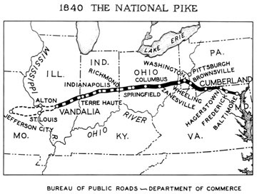
Transportation Revolution
As America expanded westward new methods of transportation were needed.
Improving Roads:
Some states created turnpikes, roads for which users had to pay a toll.
The federal government built the National Road that stretched from Maryland to Missouri.

Slide 8
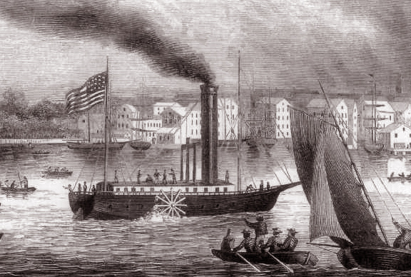
Transportation Revolution
Water travel improves and expands.
Robert Fulton invents the steamboat.
Makes travel upstream easier and faster.
Canals Boom:
These man-made waterways connected various bodies of water, linking farmland in the West to the growing cities of the East.
Erie Canal
Completed in 1825; fueled the growth of New York City and cities along its banks.

Slide 9
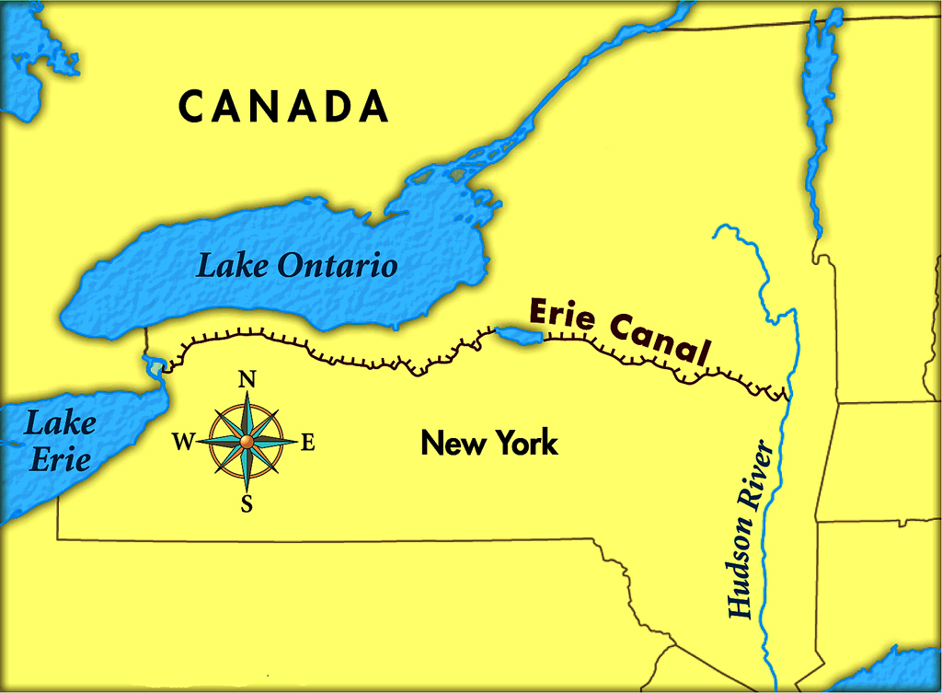

Slide 10
The (2nd) Industrial Revolution

Slide 11
Brain Pop
Industrial Revolution

Slide 12
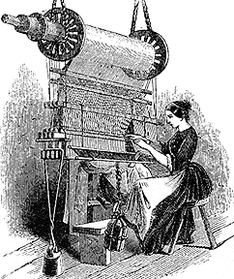
Industrial Revolution
During the Industrial Revolution, developments in technology transformed the manufacturing of products.
Textile Mills:
New machinery transformed the way textiles (cloth) were produced.
Textile mills in Lowell, MA became famous for their methods of production.

Slide 13
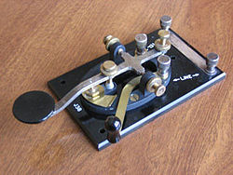
Industrial Revolution
New inventions transform industry and agriculture.
Samuel Morse
Morse invents telegraph that delivers messages via Morse code.
Relay of information becomes instant. Messages take seconds, not days to deliver.

Slide 14
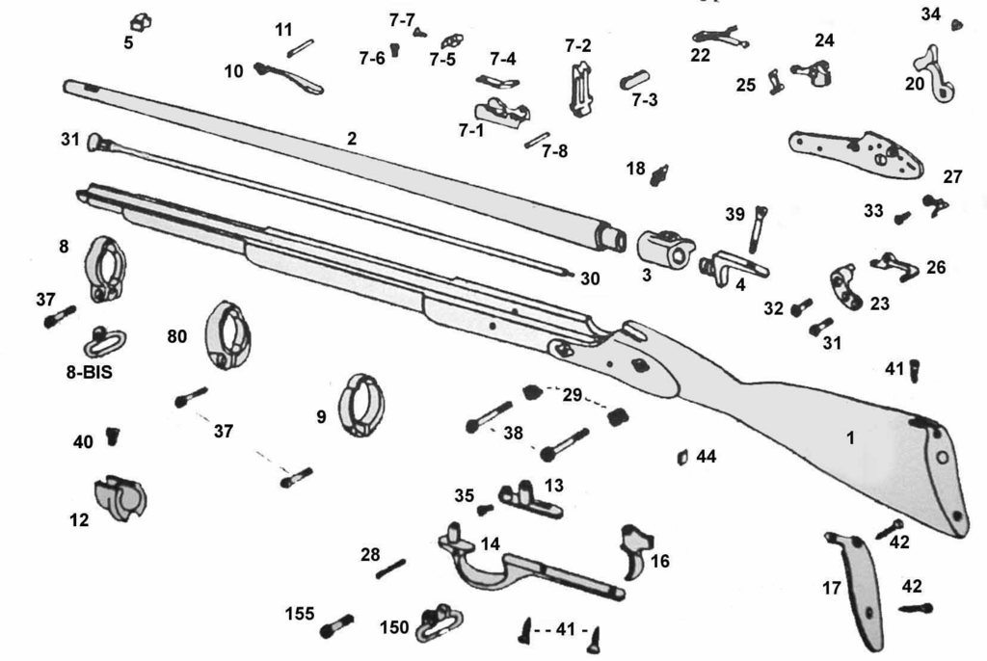
Industrial Revolution
Eli Whitney changes everything.
Interchangeable parts – identical components that can be used in place of one another
“If the trigger on the musket breaks, now you can just install a new trigger instead of buying a whole new musket.”

Slide 15
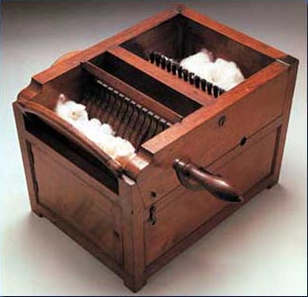
Industrial Revolution
1793 – Eli Whitney invents the cotton gin.
Cotton gin easily removes the seeds from cotton.
Faster production of cotton leads to increased demand.
Increased demand for cotton leads to increased demand for slaves.
Northern textile mills were also profiting from booming cotton industry in the South.

Slide 16
“Manifest Destiny”
Americans Head West

Slide 17
Manifest Destiny
The progress made to the American infrastructure and the technology invented to compliment that infrastructure led many Americans to move Westward in the early 19th century.
Many firmly believed that God had ordained America to expand from the Atlantic Ocean to the Pacific Ocean.
This religious belief became known as “Manifest Destiny”.

Slide 18
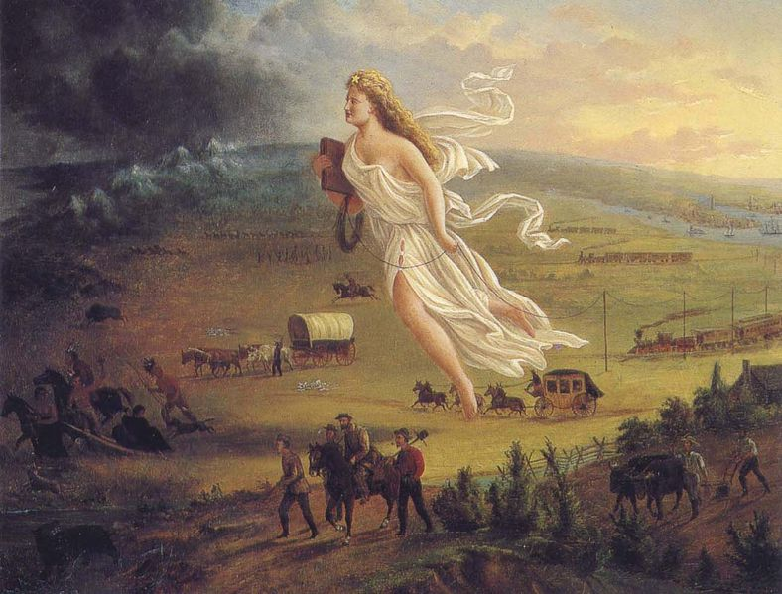

Slide 19
Brain Pop
Manifest Destiny

Slide 20
Ticket Out the Door
Pick two inventions or innovations from the list below. Explain the way your chosen advances changed the lives of Americans in the first half of the 19th century.
Turnpikes
Steamboats
canals
Textile mills
The telegraph
Interchangeable parts
The cotton gin

