Slide 1
The Industrialization of the United States
1860’s – 1910’s

Slide 2
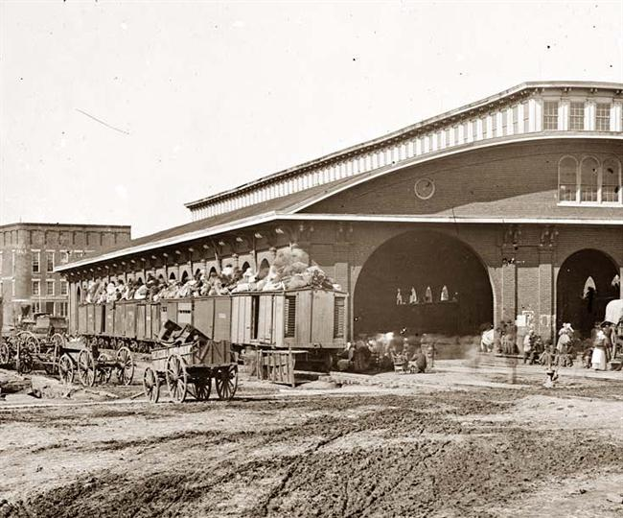
The South Builds Railways
After the Civil War, the South began building more railroads to rival those of the North.
South now relied on its own manufacturing centers.
New railway “hub” cities developed; including Dallas, TX and Atlanta, GA.

Slide 3
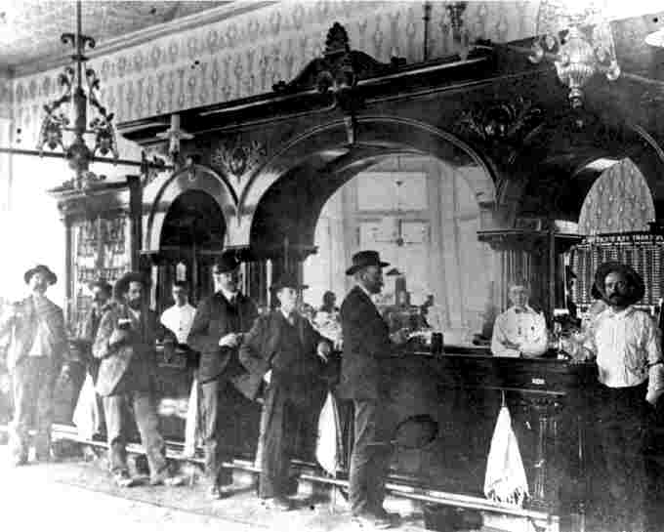
Mining Towns
During and after the Civil War, westward migration continued.
Thousands flocked West in hopes of finding gold or silver.
Around these deposits of minerals, “mining towns” developed.

Slide 4
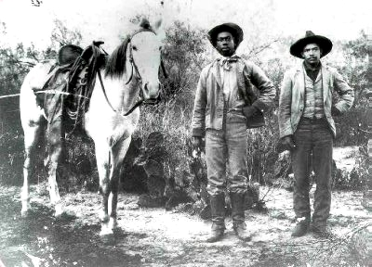
Home on the Range
Cattle ranching fueled westward migration as well.
Open prairies of the West were perfect for grazing.
Newly-invented barbed wire made ranching more efficient.
As a result, the beef industry exploded.

Slide 5
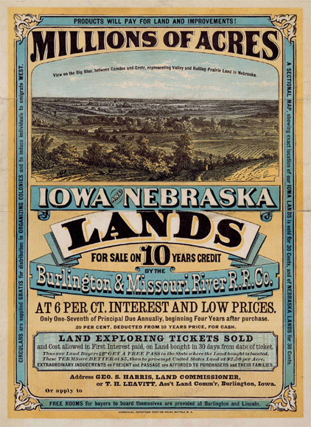
Farmers Move West
Farmers migrated West for new, fertile, cheap lands.
The Homestead Act of 1862 promised plots of land to anyone willing to move and settle in these Western lands.
Prairie states became a new agricultural center of the US

Slide 6
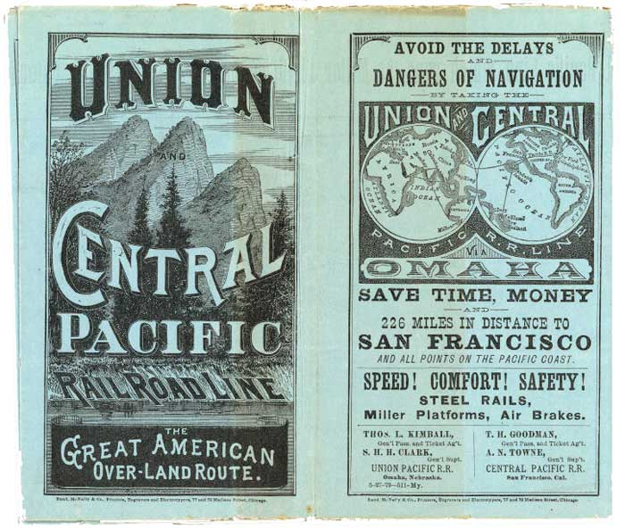
Two Companies Compete
In 1863, two different companies began construction of the Transcontinental RR.
The Central Pacific Company began laying track eastward from California.
The Union Pacific Company laid track westward from Nebraska.

Slide 7
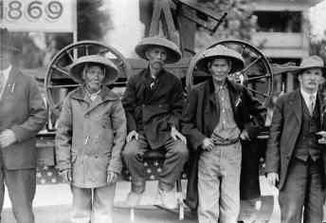
Immigrants Build Railroads
Irish immigrants in the east and Chinese immigrants in the west were used to build the railroad.
Thousands of these immigrants died due to dangerous working conditions.

Slide 8
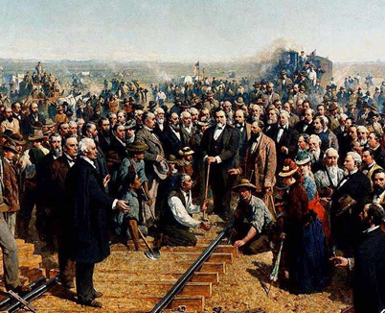
Two Tracks Meet
In 1869, the two tracks finally connected at Promontory Summit in Utah.
A symbolic golden spike was the final one driven in to mark the completion of the transcontinental railroad.

Slide 9
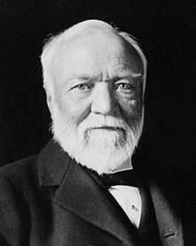
Steel Industry Transforms
1850s – Bessemer process shortens time it takes to transform iron into steel.
Andrew Carnegie (right) brings Bessemer process to the US; makes millions off steel production.

Slide 10
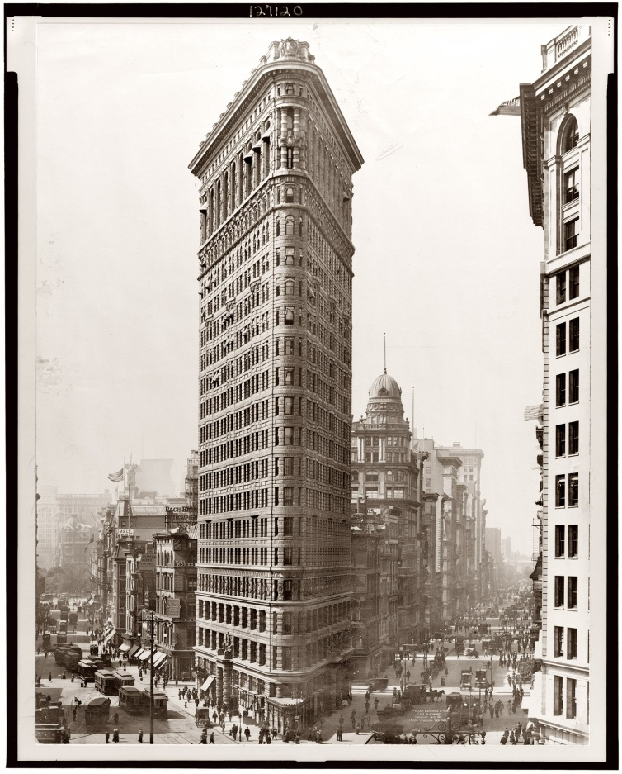
Urbanization Changes America
Cheap, efficient steel leads to the construction of skyscrapers, elevators and bridges throughout the country.
Railroads and canals allow quick, easy transport of steel.
America experiences rapid urbanization – the process of people moving from rural areas to cities

Slide 11
Industries Expand
Expanding markets now linked by railroads led to the creation of corporations.
Technology connected the nation, allowing big business to expand across the country.

Slide 12
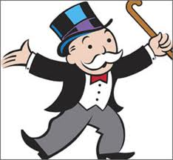
Gaining a Competitive Edge
Corporations worked to maximize profits in several ways.
Some tried to gain a monopoly
To form monopolies, companies either bought out the competition or drove them out of business.
With no competition, companies could charge whatever prices they wanted for essential products or services.

Slide 13
Gaining a Competitive Edge
Some laws prevented one company from buying out another company.
To get around this, some businessmen formed trusts.
In a trust companies assign their stocks to a board of trustees who combine them into a new, more powerful organization.

Slide 14
Horizontal v. Vertical Integration
Horizontal integration – when a company consolidates many firms into one business
Ex. All oil companies formed in to ONE.
Vertical integration – when a company gains control of all the phases involved in the production of a product
Ex. One company owns the oil well, the oil pipeline, the tankers that transport and the gas stations.

Slide 15
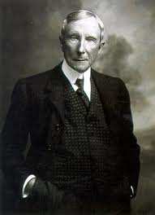
John D. Rockefeller
John D. Rockefeller
Oil tycoon (business person)
Founded the Standard Oil Company
Adjusted for inflation, Rockefeller is the richest man to have ever lived.

Slide 16
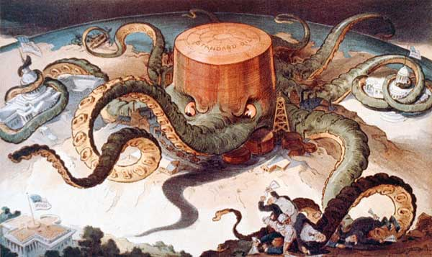

Slide 17
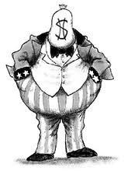
“Robber Barons”
Many began to see business practices like monopolies and trusts as giving unfair advantages to corporations.
Monopolies, cartels and trusts kept prices for products high; rich were making money at the expense of the poor.
Men like Rockefeller and Carnegie were given the nickname “Robber Barons”.

Slide 18
“Robber Barons” and Philanthropy
Despite the negatives, some saw the “Robber Barons” as “captains of industry”.
They brought jobs to the masses and were allowing America to compete in the global markets.
Rockefeller and Carnegie also practiced philanthropy; they gave away millions of dollars to fund education programs, build libraries and museums.

Slide 19
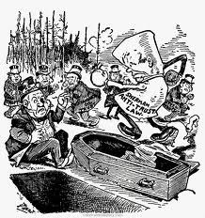
Government Restricts Trusts
Opposition formed to the unfair business practices of the trusts.
In 1890, the Senate passed the Sherman Anti-Trust Act.
The Sherman Anti-Trust Act began a trend towards the federal government limiting the power of corporations.

Slide 20
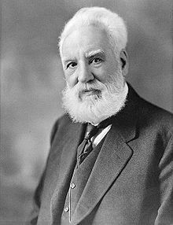
Technology Spurs Cities
In addition to skyscrapers, elevators and bridges, new inventions give rise to the American city.
1876 – Alexander Graham Bell invents the telephone

Slide 21
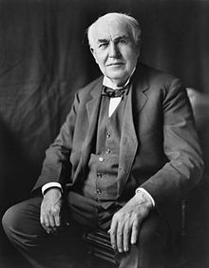
Technology Spurs Cities
Thomas Edison – famous American inventor; patented the light bulb, the phonograph and the motion picture camera.
Edison’s light bulb allowed factories to operate 24 hours a day; no longer were they only operational during daylight.
The phonograph and motion picture camera created new pastimes for many Americans.

Slide 22
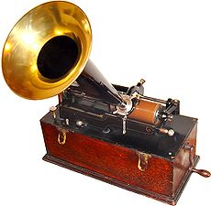
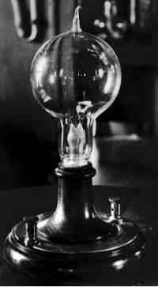
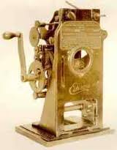

Slide 23
Edison Invention Ad
A local magazine has asked you to create an advertisement for one of Thomas Edison’s latest inventions.
Choose either the light bulb, the phonograph or the motion picture camera and create your own advertisement.
These will be collected for a grade.
The more colorful and informative, the better your grade will be.

Slide 24
Native Americans and Westward Expansion

Slide 25
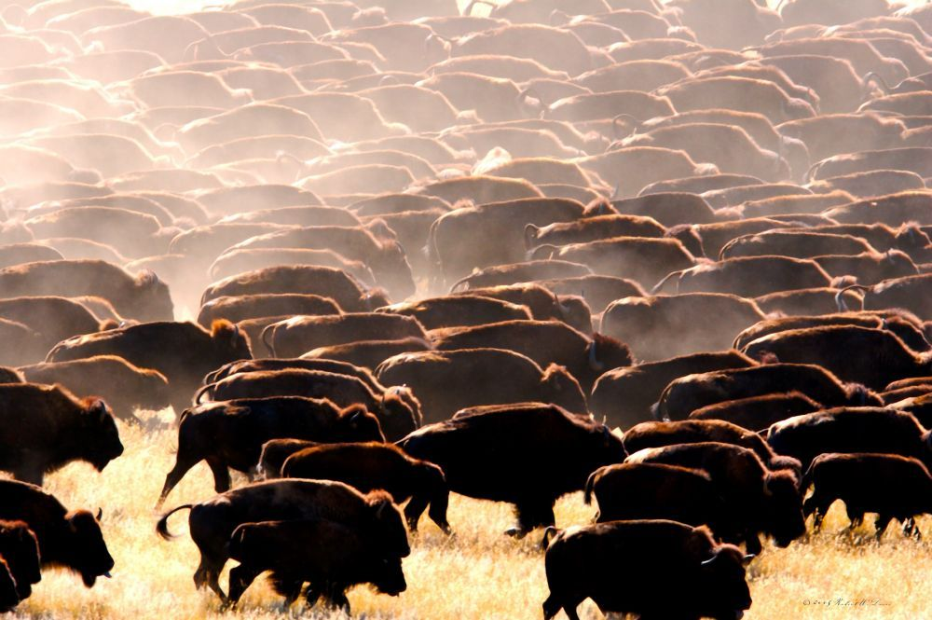
Westward Expansion and Native Americans
In the 1860s, the US government began forcing Native Americans onto reservations.
Settlers pushed the buffalo (a sacred animal in Native traditions) to the brink of extinction.
Faced with no other options, Native Americans had no choice but to fight back.

Slide 26
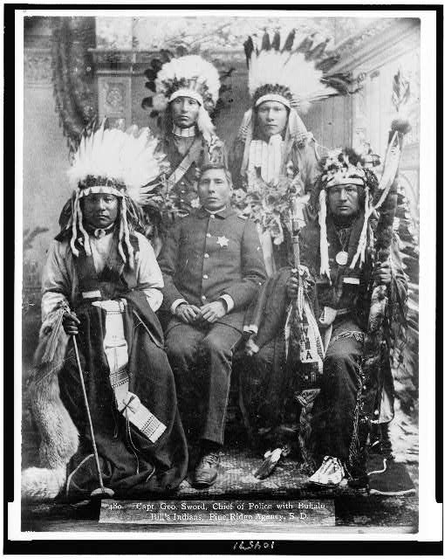

Slide 27
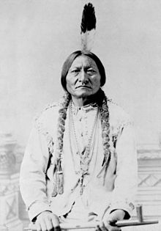
Westward Expansion and Native Americans
In 1875, gold was discovered in the hills of South Dakota.
Miners began settling on Sioux tribal lands in search of gold.
Sioux leader, Sitting Bull, assembled his own army of Natives to drive the settlers out.

Slide 28
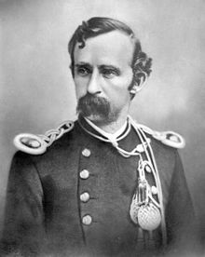
Battle of Little Big Horn
In June 1876, the US sent General George Custer to battle the Sioux.
Custer’s 700 men were slaughtered by 7,000 Sioux Indians at the Battle of Little Big Horn.
The US Army retaliated, crushing the Sioux, and forcing Sitting Bull to flee to Canada.

Slide 29
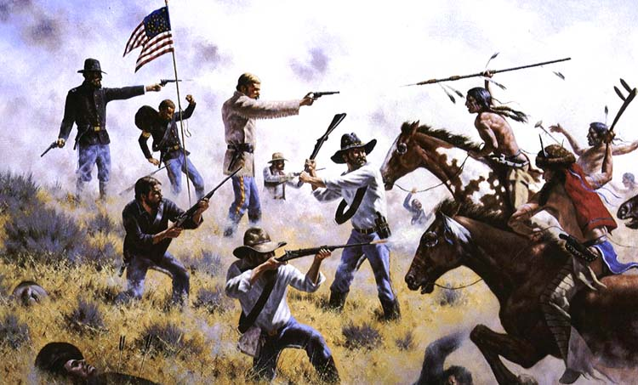

Slide 30
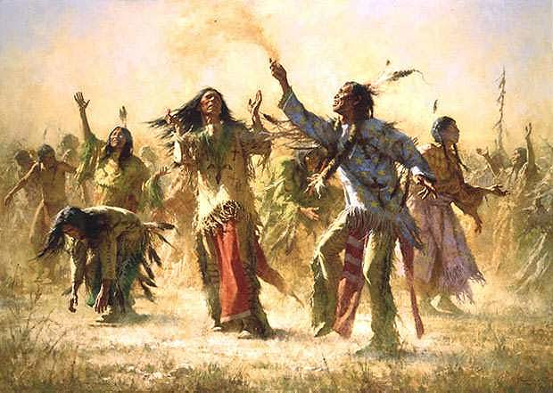
Ghost Dance Brings Hope
In response to the loss of their land and the buffalo, many Natives welcomed a religious revival based on the Ghost Dance.
Fearing the Ghost Dance would cause problems, the US government ordered the capture and arrest of Sitting Bull.
In a confrontation over his arrest, Sitting Bull was killed.

Slide 31
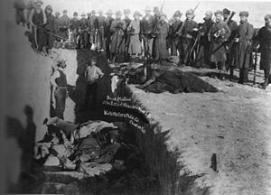
Wounded Knee Massacre
As Natives fled after Sitting Bull’s murder, troops were sent out to capture them.
At Wounded Knee Creek, troops slaughtered over 100 Native men, women and children.
The Wounded Knee Massacre effectively ended the Native attempts to push back the white settlers.

Slide 32
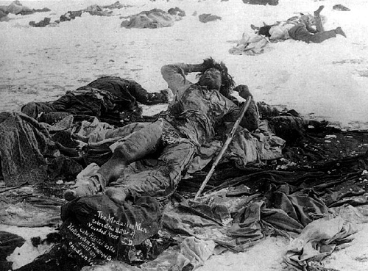

Slide 33
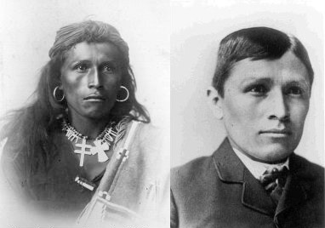
Natives Forced to Assimilate

Slide 34
Immigration

Slide 35
Cities Offer Opportunity
With help from new railroad lines, cities become magnets for rural Americans.
Factories offer work for skilled laborers, job opportunities for women and education for children.
Seizing on these new opportunities, a new waves of immigrants began arriving on America’s shores.

Slide 36
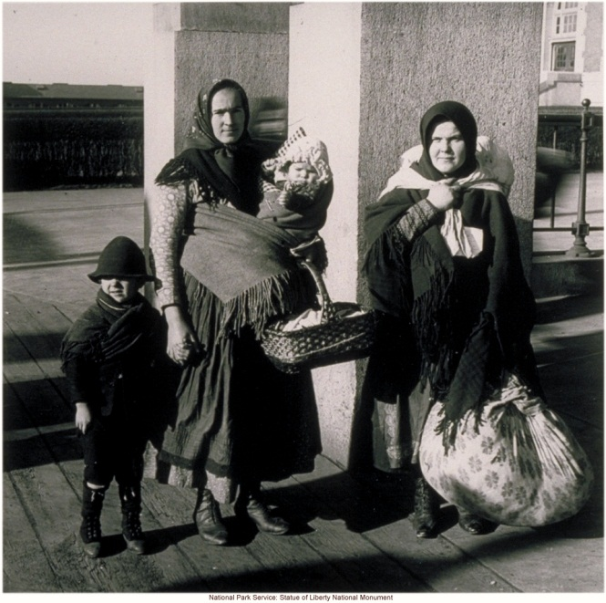
Immigrants Flock to America
Beginning in the mid-1800’s, the origins of immigrants change from Western Europe to Southern and Eastern Europe.
Hundreds of Italian, Polish and Russian immigrants arrived daily.
Many immigrants were forced to live in tenements – low-cost, urban family housing developments that squeezed in as many families as possible.

Slide 38
The Immigrant Experience
Ellis Island – Port in New York Harbor that processed immigrants coming from Europe.
Angel Island – Port in San Francisco Bay that processed immigrants coming from Asia.

Slide 39
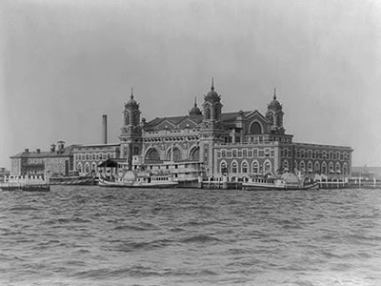
Ellis Island

Slide 40
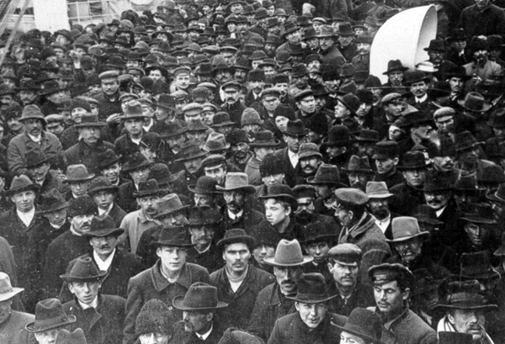

Slide 41
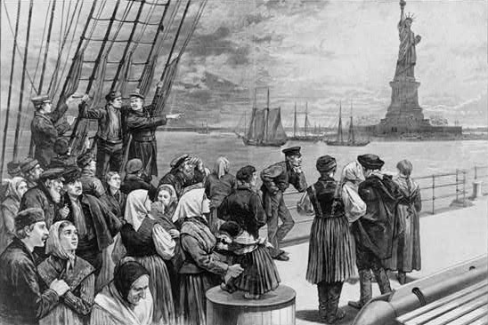

Slide 42
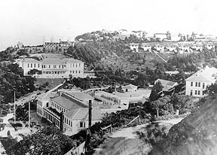
Angel Island

Slide 43
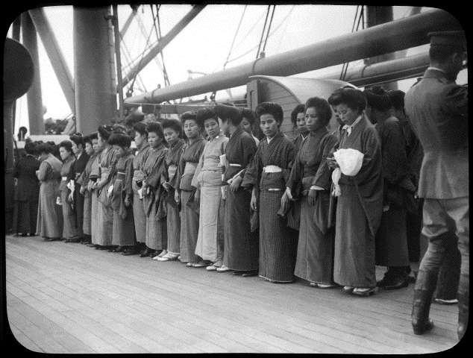

Slide 44
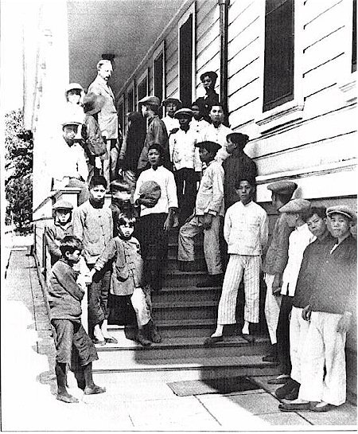

Slide 45
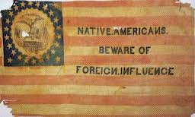
Resistance Towards Immigration
Nativism – a belief that native-born white Americans were superior to newcomers.
Similar to the fate of Native Americans, many immigrants were forced to assimilate to American culture.

Slide 46
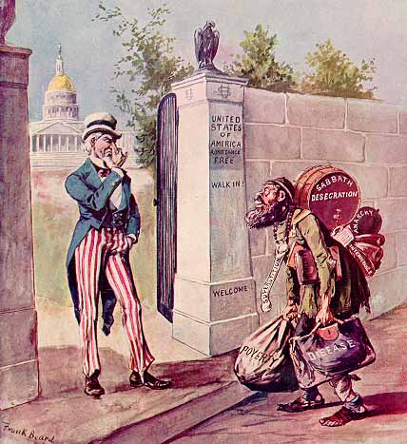

Slide 47
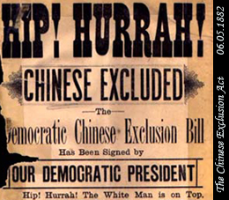
Chinese Exclusion Act
With rising pressure from nativists, Congress passed the Chinese Exclusion Act in 1882.
Act prohibited Chinese immigration to the US and limited the rights of the Chinese immigrants already living in the country.
Marked the first time that a specific racial groups was forbidden to enter the United States.

Slide 48
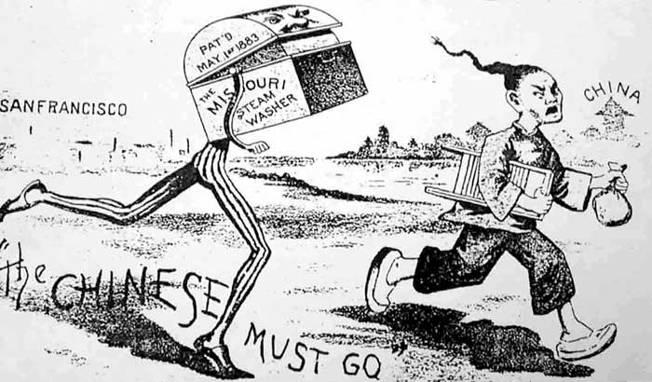

Slide 49
The Organized Labor Movement

Slide 50
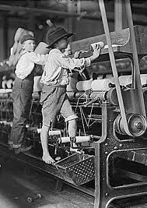
Factory Life Proves Dangerous
In the late 19th century, factory owners employed various ways to maximize profits and keep costs low.
They hired children and immigrant labor that would work for low wages.
They forced workers to work 12 hour days and 6 day work weeks.
Little attention was given to safety. Many workers died from factory accidents.

Slide 51
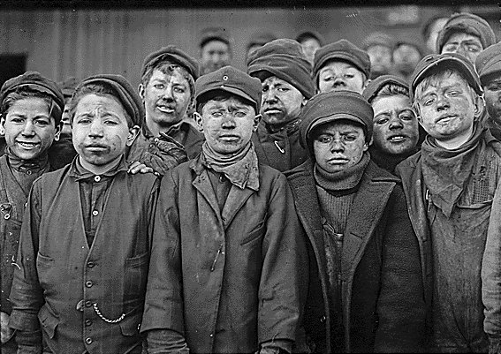

Slide 52
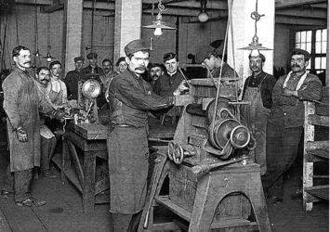

Slide 53
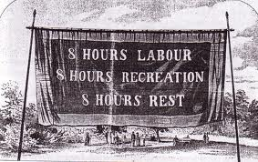
Labor Unions Form
Despite increased production and lowered costs, many who worked the factories still could not afford basic necessities.
Many workers began to practice collective bargaining with their employers; negotiating for higher wages and better working conditions.
One form of protest used was the strike – when workers refuse to work until their demands are met.

Slide 54
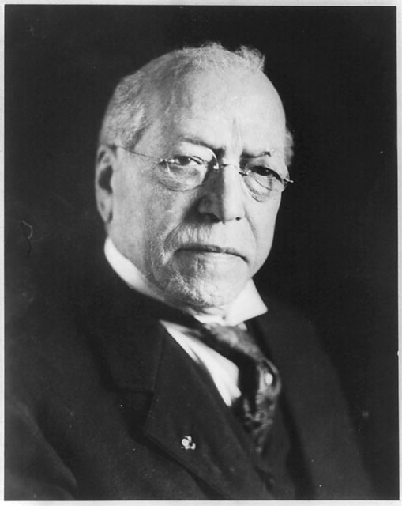
Samuel Gompers
Samuel Gompers
1886 – Gompers founded the AFL (American Federation of Labor)
The AFL union worked to improve wages, working conditions and working hours for its members.

Slide 55
Pullman Strike
Turn to page 456 in textbook
3 readers (Pullman Strike, Company Town, Main Players)

Slide 56
Vocabulary Pull Out
Write the top 10 words needed to summarize on the blue strips

Slide 57
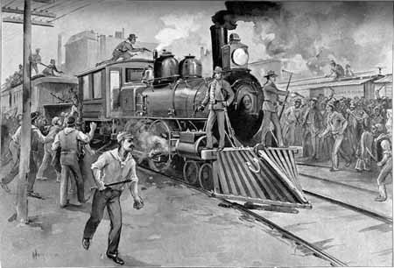
Pullman Strike of 1894
George Pullman – owner of a company that produced luxury railroad cars
In May 1894, workers began a strike protesting wage cuts and layoffs.
The strike grew violent with many protestors destroying rail lines and equipment.

Slide 58
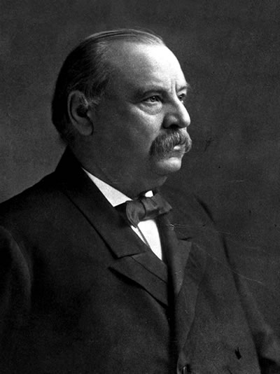
Federal Government Responds to the Pullman Strike
Because the Pullman Strike was interrupting the delivery of federal mail, President Grover Cleveland (right) took action.
12,000 federal troops were sent to stop the protestors.
When troops arrived, riots broke out which led to the deaths of 30 people.

Slide 59
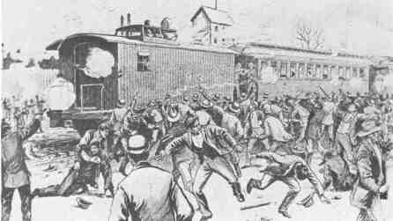

Slide 60
Effects of the Pullman Strike
After the Pullman Strike and other instances of industrial unrest, many employers began to use the court system to reduce the power of labor unions.
For the next 30 years, the federal government would argue with labor unions and employers over a number of work-related issues.

Slide 61
History of Labor Day
http://www.history.com/videos/history-of-labor-day#history-of-labor-day

Slide 62
Transcontinental Railroad TOD
It’s 1869. Your job is to promote the upcoming “joining of the railroads” at Promontory, Utah.
Create a promotional flyer that you might want to hand out or write a letter to a friend inviting them to join you at the ceremony.
Be sure to include the who, what, when, where and why of the event!!!
Turn these in before class ends.

Slide 63
Labor Unions T.O.D.
Imagine you are a worker during the Pullman Strike in 1894.
It is your job to create a protest sign that you would carry at one of the demonstrations.
Your sign must include some reference to the Pullman Railway Cars AND one or two demands of your labor union.
These will be taken up and graded.

Slide 64
John D. Rockefeller
http://www.history.com/videos/john-d-rockefeller-oil-money-and-power#john-d-rockefeller-oil-money-and-power

