Slide 1
The Development of British North America
EQ: How did the American colonies change during British colonization?

Slide 2
Georgia Standards
SSUSH2 The student will trace the ways that the economy and society of British North America developed.
a. Explain the development of mercantilism and the trans-Atlantic trade.
b. Describe the Middle Passage, growth of the African population, and African-American culture.
c. Identify Benjamin Franklin as a symbol of social mobility and individualism.
d. Explain the significance of the Great Awakening.

Slide 3
Vocabulary
Mercantilism- system that the “mother country” gains financial benefits from its colonies at the colonies’ expense
Imperialism--Ruling over extensive territories or over colonies
Individualism-- Belief in the primary importance of the individual and in the virtues of self-reliance and personal independence
Social Mobility- an individual's social status can change throughout the course of his or her life

Slide 6
International Development

Slide 7
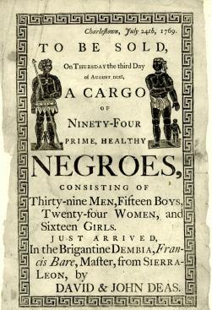
Trans-Atlantic Trade
Between 16th and 19th century, Europe exported over 12 million slaves across the Atlantic Ocean
Africans enslaved other Africans
Labor used on sugar, cocoa, coffee and cotton plantations.

Slide 8
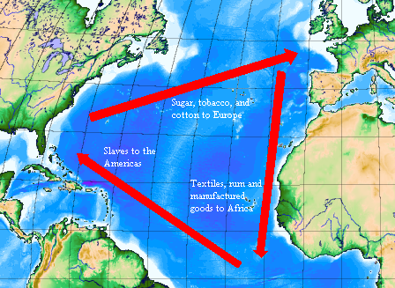
Trans-Atlantic Trade
Triangular trade –
Africa: Slaves to Americas
Americas: shipping raw goods in Europe (sugar, cocoa, coffee and cotton)
Europe: selling goods back to Africa and Americas

Slide 9
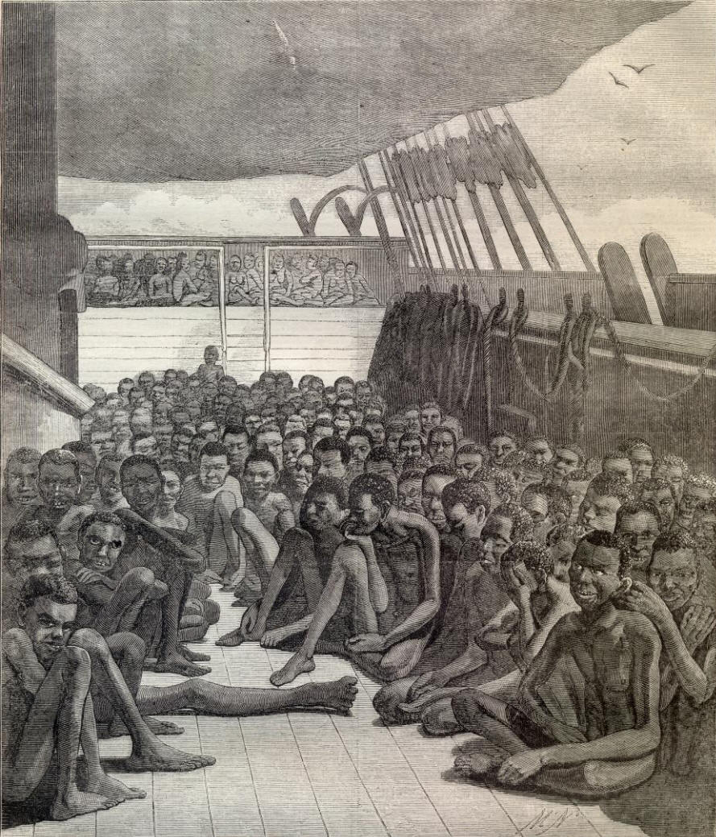
“The Middle Passage”
The voyage across the Atlantic Ocean on slave ships was known as the Middle Passage.
Conditions were horrific. Slaves were chained and stacked on top of each other like cargo.
Usually only half survived the two month journey.

Slide 10
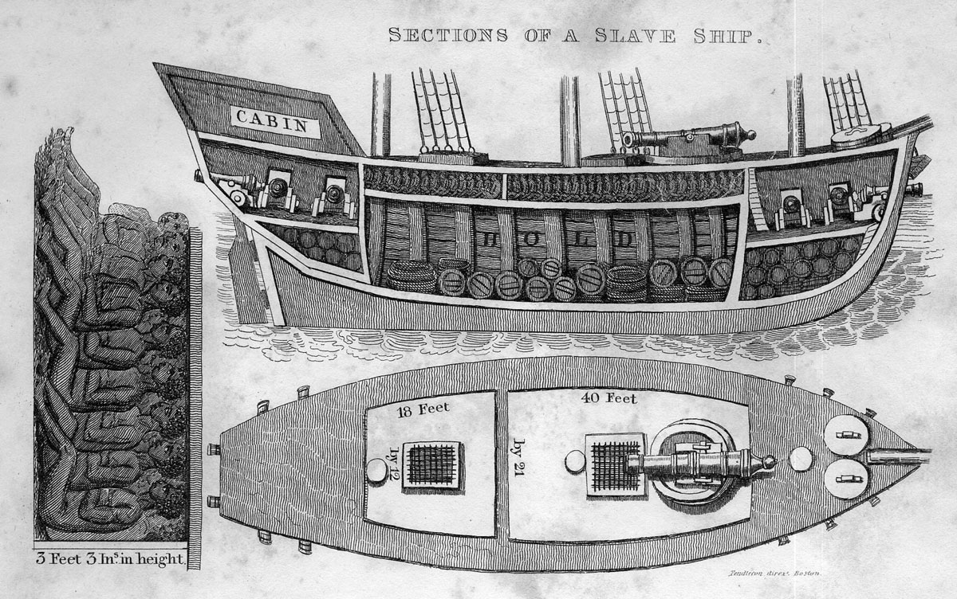

Slide 11
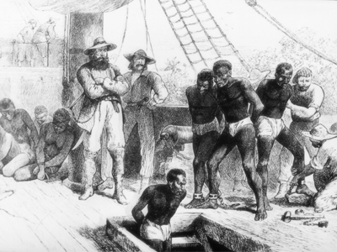

Slide 12
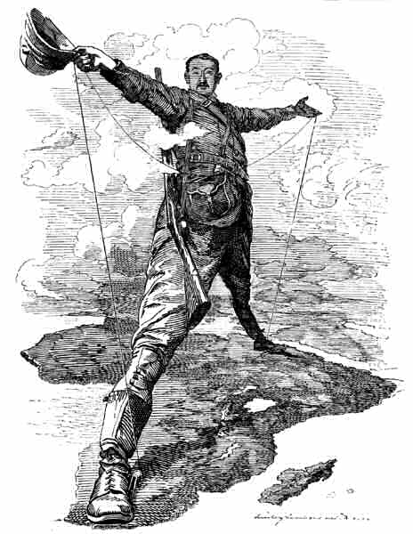
European Colonization
In the 17th - 19th century, Europeans took more steps to dominate the rest of the world.
They wanted to own the vast land and resources that other nations had to offer (IMPERIALISM)
Mercantilism – theory that the “mother country” gains financial benefits from its colonies at the colonies’ expense
Consequently, as a nation became stronger through mercantilism, its enemies became weaker.

Slide 13
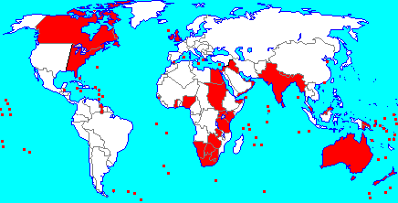
The sun never sets on the British Empire.

Slide 14
Answer: British and the French
The battle over colonies will force the British and the French to do battle for imperial control of those colonies.
Part of that war will be fought for colonial rights to North America.
In this country, it is known as “The French and Indian War”

Slide 15
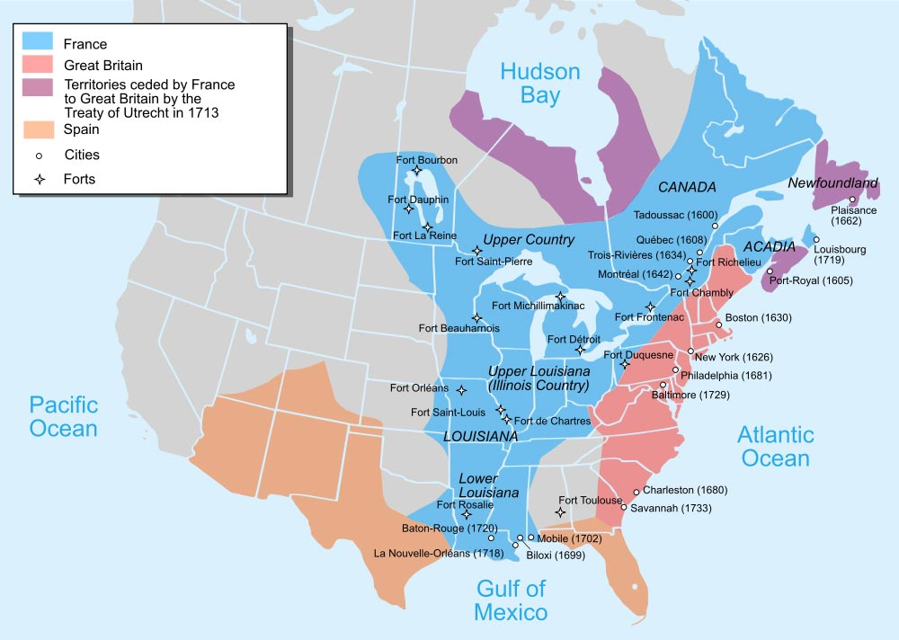

Slide 16
Domestic Developments

Slide 17
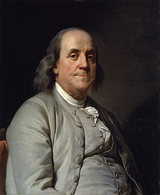
Benjamin Franklin
In the 1700’s, the life of Benjamin Franklin represented changes in society.
Franklin was able to rise in society from a very poor, humble beginning to a life of wealth, accomplishment and fame.
This upward move in society is called “social mobility”.
Through his writings, Franklin promoted individualism, in which he stressed the importance of individuals in society.
This idea led to a shift in power from institutions (i.e. Church, monarch) to individuals (i.e. “common citizens”)

Slide 18
The Great Awakening
In the 1700’s, American religion changed dramatically.
During “The Great Awakening”, the colonies experienced a dramatic increase in religion.
The period is best remembered for its preachers and their passionate, intense sermons.
Sermons placed emphasis on individual religious experience rather than religious experience through church doctrine (beliefs).
Laid the groundwork for the strong, religious origins in the fight for independence
“If salvation was to be reached through personal understanding and interpretation (not mandated by the Church), shouldn’t government also be the same?”

Slide 19
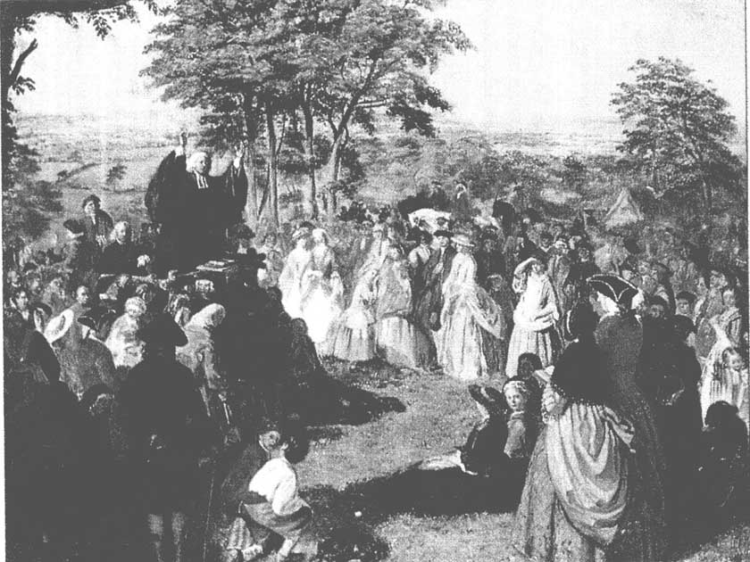

Slide 20
