Slide 1
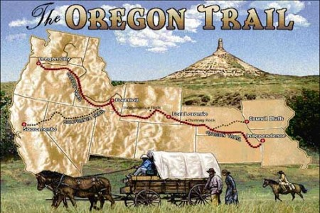
Facts from video

Slide 2
Georgia Standards
SSUSH6 The student will analyze the nature of territorial and population growth and the impact of this growth in the early decades of the new nation.
b. Describe Jefferson’s diplomacy in obtaining the Louisiana Purchase from France and the territory’s exploration by Lewis and Clark.
c. Explain major reasons for the War of 1812 and the war’s significance on the development of a national identity.
e. Describe the reasons for and importance of the Monroe Doctrine.

Slide 3
Land Ordinance of 1785 and the Northwest Ordinance of 1787

Slide 4
Land Ordinance
Ordinance—a law given by a governmental authority
Only achievement of Confederation Congress
Law designed to bring in revenue through sale of western land – Ohio River Valley
Colonies or new states – Jefferson’s Empire of Liberty Idea
Adopt a State Plan – Land Ordinance and Northwest Ordinance

Slide 5
Land Ordinance of 1785
Orderly/step by step process of added states [not colonies] to America
how the new US government would measure, divide and distribute the land it had acquired from Great Britain north and west of the Ohio River at the end of the war
Created method of surveying land – created townships – grid system
Townships – 6 square miles – 36 sections
16th section of township dedicated to public education

Slide 7
Northwest Ordinance 1787
Explained how territories would be governed
Provided a step by step method to move territories to become states
Congress chooses a territorial governor, secretary and judges
5,000 adult male citizens can elect a territorial legislature
60,000 population citizens can apply for statehood = Adoption
Guaranteed rights in the territories
Freedom of – religion, property rights, trial by jury (Bill of Rights)
Banned spread of slavery into the territories

Slide 8
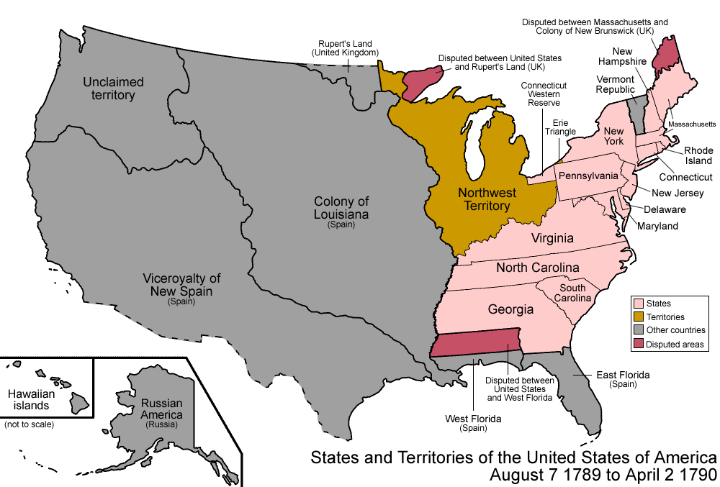

Slide 9
Results of Ordinances
Outlined the steps for a territory to apply for statehood.
BANNED SLAVERY in these territories:
Ohio, Indiana, Illinois, Michigan, Wisconsin and parts of Minnesota
Led to increased interaction with Natives; broke the promise of the Proclamation of 1763
Called for establishment of free public schools

Slide 10
Growth of the New Nation
(c. 1800-1820’s)

Slide 11
Thomas Jefferson and the Louisiana Purchase

Slide 12
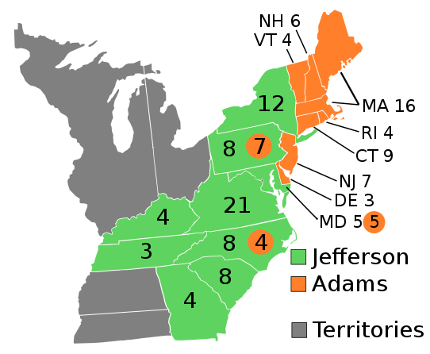
Jefferson Victorious in 1800

Slide 13
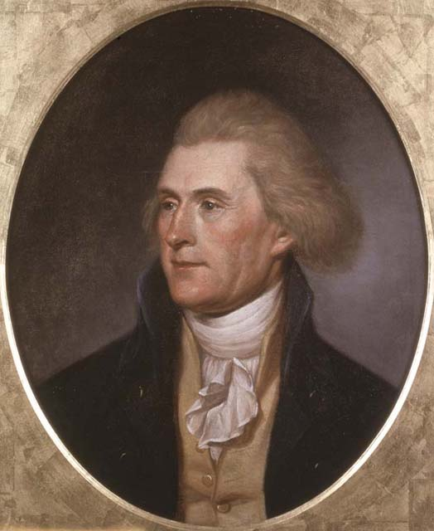
Thomas Jefferson
Democratic-Republican
Plantation Owner from Virginia
States’ Rights supporter
Repealed Alien and Sedition Acts

Slide 14
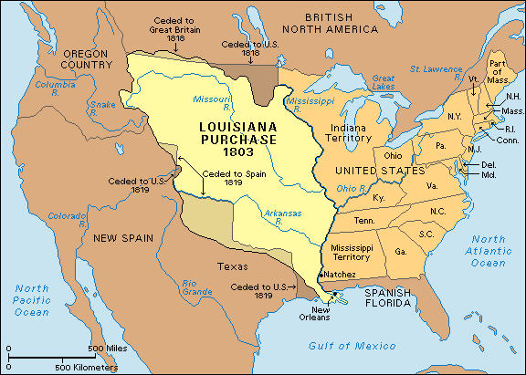
Jefferson’s Purchase from France

Slide 15
The Louisiana Purchase (1803)
The area known as Louisiana switched hands many times, but now was controlled by the French.
President Jefferson, wanting access to the port of New Orleans, decided to make an offer to Napoleon for control of that port.
Napoleon (who was in debt from war) decided to sell Jefferson not just New Orleans but ALL of Louisiana.
The Louisiana Purchase doubled the size of the country and brought with it many valuable resources.

Slide 16
Why sell? Why Buy?
Napoleon Bonaparte needed money to continue his conquest of Europe
N B wanted to prevent US / Britain alliance
April 30, 1803 – One of the greatest land deals in history
Jefferson’s reasons to buy
Fit into his agrarian vision for America – republic can only survive is people had chance to own land
Opportunity to gain control of Mississippi River
Great bargain – Doubled size of America

Slide 17
Jefferson’s Dilemma
a situation in which a difficult choice has to be made between two or more alternatives, especially equally undesirable ones
Thomas Jefferson (as an Anti-Federalist) believed that the power of the federal government (including the President) should be limited.
His views on the Constitution were those of a strict constructionist: meaning that he followed the Constitution “word for word”.
He felt that the purchase of Louisiana was unconstitutional; the Constitution did not specifically give the President the authority to buy territory.
He decided however that the deal was too good to pass up and went through with the purchase.

Slide 18
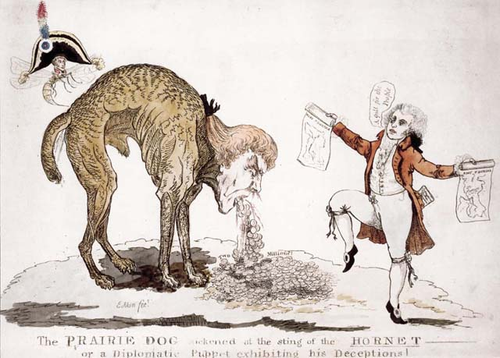

Slide 19
Lewis and Clark
No one knew exactly what the lands between the Mississippi River and the Pacific Ocean held.
In an effort to explore the new territory, Jefferson sent out an expedition team headed by Meriwether Lewis and William Clark.
The team charted trails, rivers and mountains, discovered new species and interacted with Native American tribes.
Also staked American claim to the West coast, allowing us to eventually acquire more territory.

Slide 20
Results of Expedition
First of many explorations into the unknown to be undertaken by America
Precedent – exploration spirit part of spirit of America
Reported stories encouraged migration westward
Dispelled myth of “Great American Desert”
Expanded knowledge of habitat, Indians, and animals
Help to give America claim of Oregon Territory along w/Britain

Slide 21
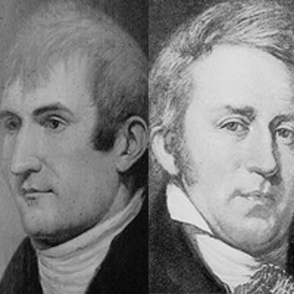
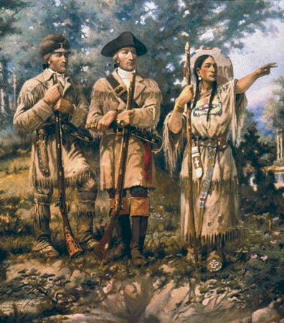
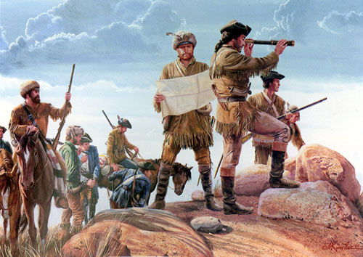

Slide 23
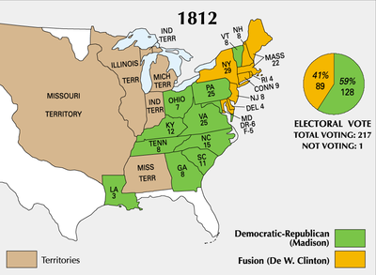

Slide 24
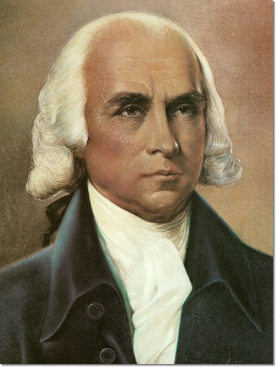
James Madison
Elected President in 1812
Democratic-Republican
“Father of the Constitution”
Co-author of the “Federalist Papers”

Slide 25
Dispute with Great Britain
For the first decade of the 19th century, American merchant ships had been caught in the middle of an on going fight between England and France.
Jefferson was able to avoid war with these countries through diplomacy and economic embargoes.
However hostilities intensified and in 1812, President Madison asked Congress to formally declare war on Great Britain.

Slide 26
Causes of the War of 1812
Second American Revolution?
England was interfering with American trade with France.
British ships were boarding American vessels and forcing sailors to serve in the British navy, a process called impressment.
England had not fully abandoned forts in North America and were helping Native Americans fight westward settlers.
America wanted to invade Canada and take it from English control.

Slide 27
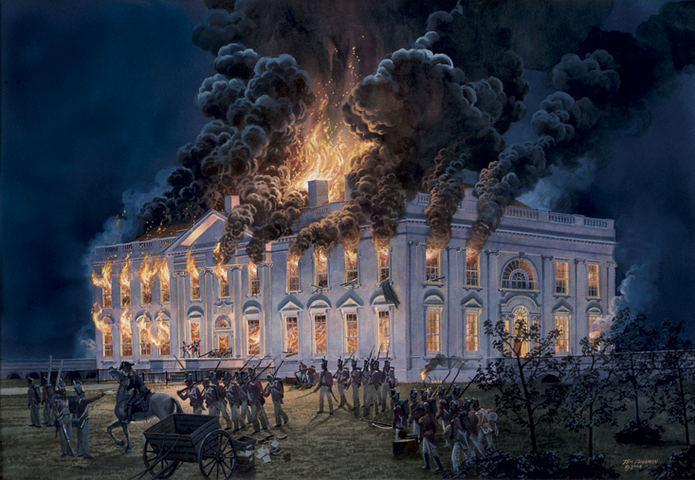

Slide 28
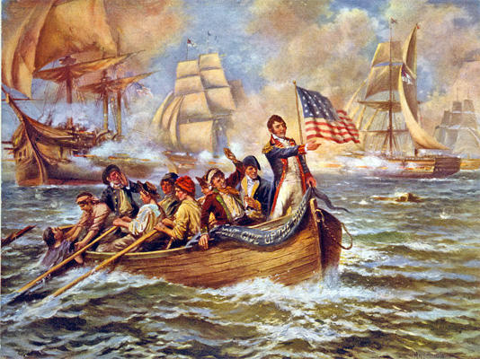
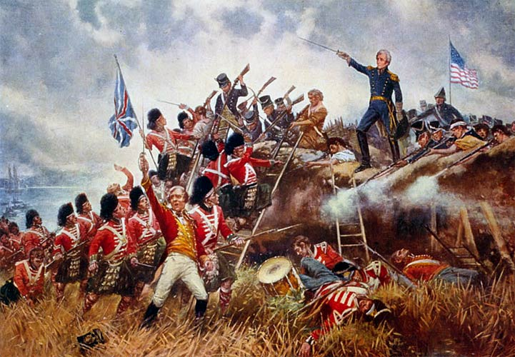
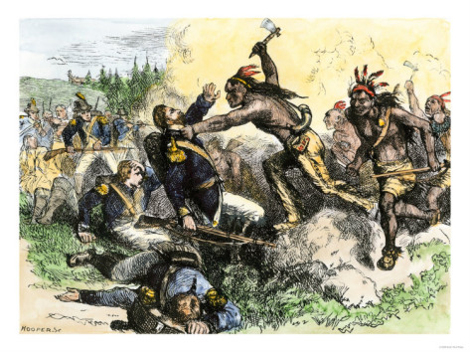

Slide 29
Results of the War of 1812
War ended in a draw.
America neither lost nor gained any new territory.
Increased respect for American army and navy throughout the world
End to Native American resistance in the Ohio River Valley
Signaled an end to the Federalist Party, who refused to support the war.
Stimulated American industry
Final official dispute with England
Uniting, fighting against the world’s most powerful nation and surviving again! Created a sense of pride and patriotism (NATIONALISM)

Slide 30
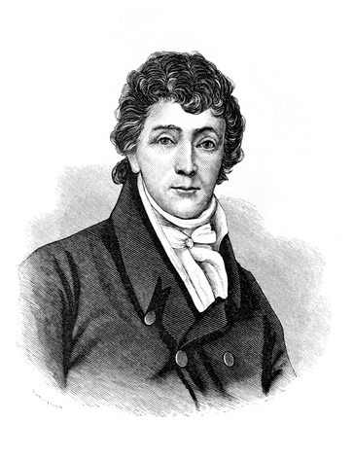
Star-Spangled Banner
While imprisoned on a British ship, Francis Scott Key penned “The Star-Spangled Banner”.
The song embodied a new spirit for the American people.
Even after being independent of England for over 30 years, many still held to their English roots.
The “victory” in the War of 1812 ushered in a period of intense nationalism and pride in being an America.

Slide 31
O say can you see, by the dawn’s early light,
What so proudly we hail’d at the twilight’s last gleaming,
Whose broad stripes and bright stars through the perilous fight
O’er the ramparts we watch’d were so gallantly streaming?
And the rocket’s red glare, the bombs bursting in air,
Gave proof through the night that our flag was still there,
O say does that star-spangled banner yet wave
O’er the land of the free…
…and the home of the brave?

Slide 32
The Monroe Doctrine

Slide 33
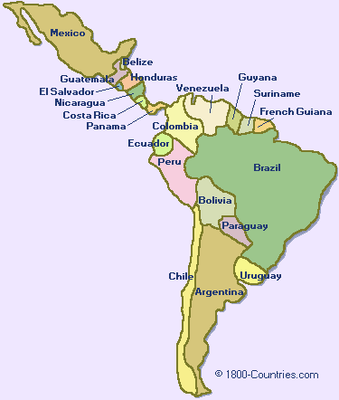
The Americas Gain Independence
During the early 1800’s, many Central and South American nations gained their independence from Spain and Portugal.
In the 1820’s, these European nations set their sights on recolonizing these recently freed nations.

Slide 34
Monroe Doctrine
Named after President James Monroe “the Good Feelings Era” president
Background Information
Latin American nations declared independence from Spanish rule – 1824
British and American enjoyed trade benefits with independent Latin American nations
To stop independence movements in Europe – Austria, Prussia, and Russia wanted to help Spain regain control of Latin American Colonies
British officials sought joint US/British resolution against European involvement in Latin American nations

Slide 35
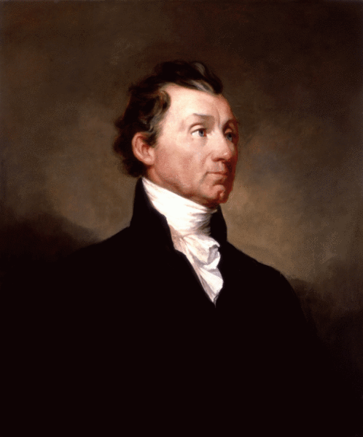
The Monroe Doctrine
In reaction to this attempt to recolonize parts of Central and South America, American President James Monroe issued the “Monroe Doctrine” in 1823.
The doctrine stated that the United States would not tolerate Europeans meddling in the affairs of the Western hemisphere.

Slide 36
Monroe Doctrine
President Monroe declared in 1823 – the American continents were “henceforth not to be considered as subjects for future colonization by any European power.”
Beginning of long term American policy of protecting Latin America from Europe
In return US promises not to get involved in European affairs – maintains Washington’s neutrality policy
Asserted America’s growing nationalism

Slide 37
Monroe Doctrine
The occasion has been judged proper for asserting, as a principle in which the rights and interests of the United States are involved, that the American continents, by the free and independent condition which they have assumed and maintain, are henceforth not to be considered as subjects for future colonization by any European powers.
- Monroe Doctrine
December 2, 1823

Slide 38
Ticket Out the Door
You are an American living in the year 1823.
You are upset at the prospect that European countries might attempt to recolonize your neighbors to the south.
Create a protest sign that clearly relates your disgust at this idea of re-colonization.
Your sign must include the following words:
1. Monroe Doctrine
2. Europe
3. Western Hemisphere

